Slide 1
The Psychology of Sport Injury and Rehabilitation: Case Studies
Dr. Monna Arvinen-Barrow
CPsychol AFBPsS (United Kingdom); CMPC FAASP (United States); UPV sert. (Finland)
Notes:
Thank you for that introduction, Kent. It is my pleasure to be here today. Before I get started, I want to share few disclaimers for this talk.

Slide 2
Purpose
To utilize case studies to emphasize the importance of a holistic, interprofessional approach to sport injury management and patient care.
To briefly demonstrate ways in which practitioners and athletes can transfer psychological skills to an injury and rehabilitation setting to enhance recovery and well-being.

Slide 3
My disclaimers:
I am not an athletic trainer, occupational therapist, physiotherapist, physical therapists, sport therapist (or any other equivalent depending on the country context).
CPsychol AFBPsS, CMPC FAASP, UVP sert.
I do not claim to understand all that goes into being one of the above professionals.
It is not my role to advice on how said rehab professionals should do their job.
It is my role to understand and respect all that they do, and to work ALONGSIDE them.
Today, I will use an overarching term sport medicine professional to refer to all professions that work with injured athletes.

Slide 4
Hess et al., 2019 (adapted from Aoyagi & Poczwardowski, 2013)
High Level of Abstraction
(theoretical models and paradigms)
Biomedical Model
Biopsychosocial Models
Biopsychosocial Model of sport injury rehabilitation (Brewer et al., 2002)
Integrated Model of psychological response to sport injury and rehabilitation process (Wiese-Bjornstal et al., 1998)
Medium Level of Abstraction
(professional practice frameworks or approaches)
Lone physician approach
Interprofessional team approach
Low Level of Abstraction
(individual techniques and interventions)
Unidimensional interventions
Multidimensional interventions
Notes:
Historically, sport injury prevention, diagnosis, and treatment has been focused on the elimination of biological defects (Engel, 1977)
Over the past five decades a growing body of literature has highlighted the significant role psychosocial aspects play in sport injury (Arvinen-Barrow & Clement, 2024)
The field has seen a shift towards more holistic, athlete-centered, biopsychosocial approach to sport injury (Arvinen-Barrow & Clement, 2019; Brewer & Redmond, 2017)
Although a body of evidence exists in support of biopsychosocial approach to sport injury rehabilitation, very little is known how such works in practice (Hess et al., 2019).

Slide 5
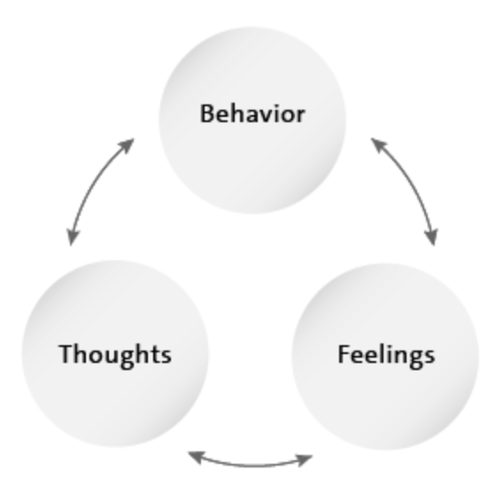
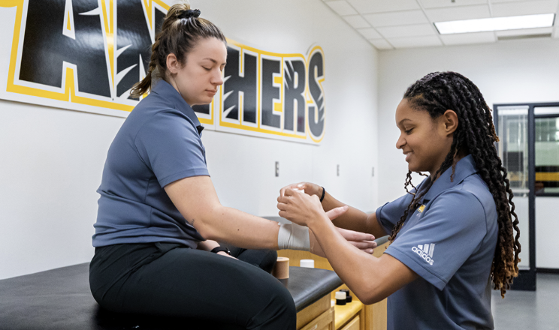
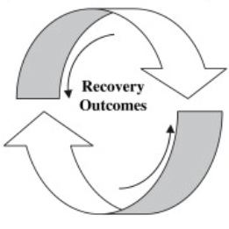
Psychology in Injury Rehabilitation (Brewer et al., 2002)
Characteristics of the Injury
Sociodemographic Factors
Biological Factors
Psychological Factors
Social/Contextual Factors
Intermediate Biopsychosocial Outcomes
Sport Injury Rehabilitation Outcomes
Notes:
What does biopsychosocial approach look like?

Slide 6
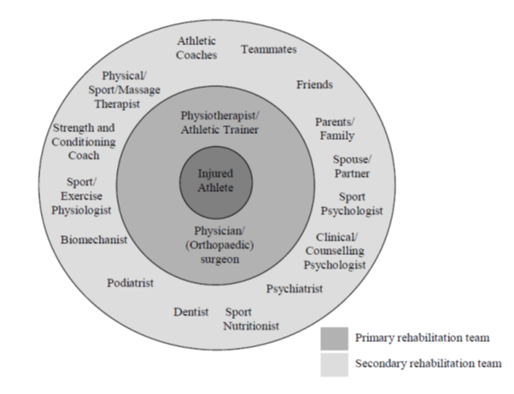
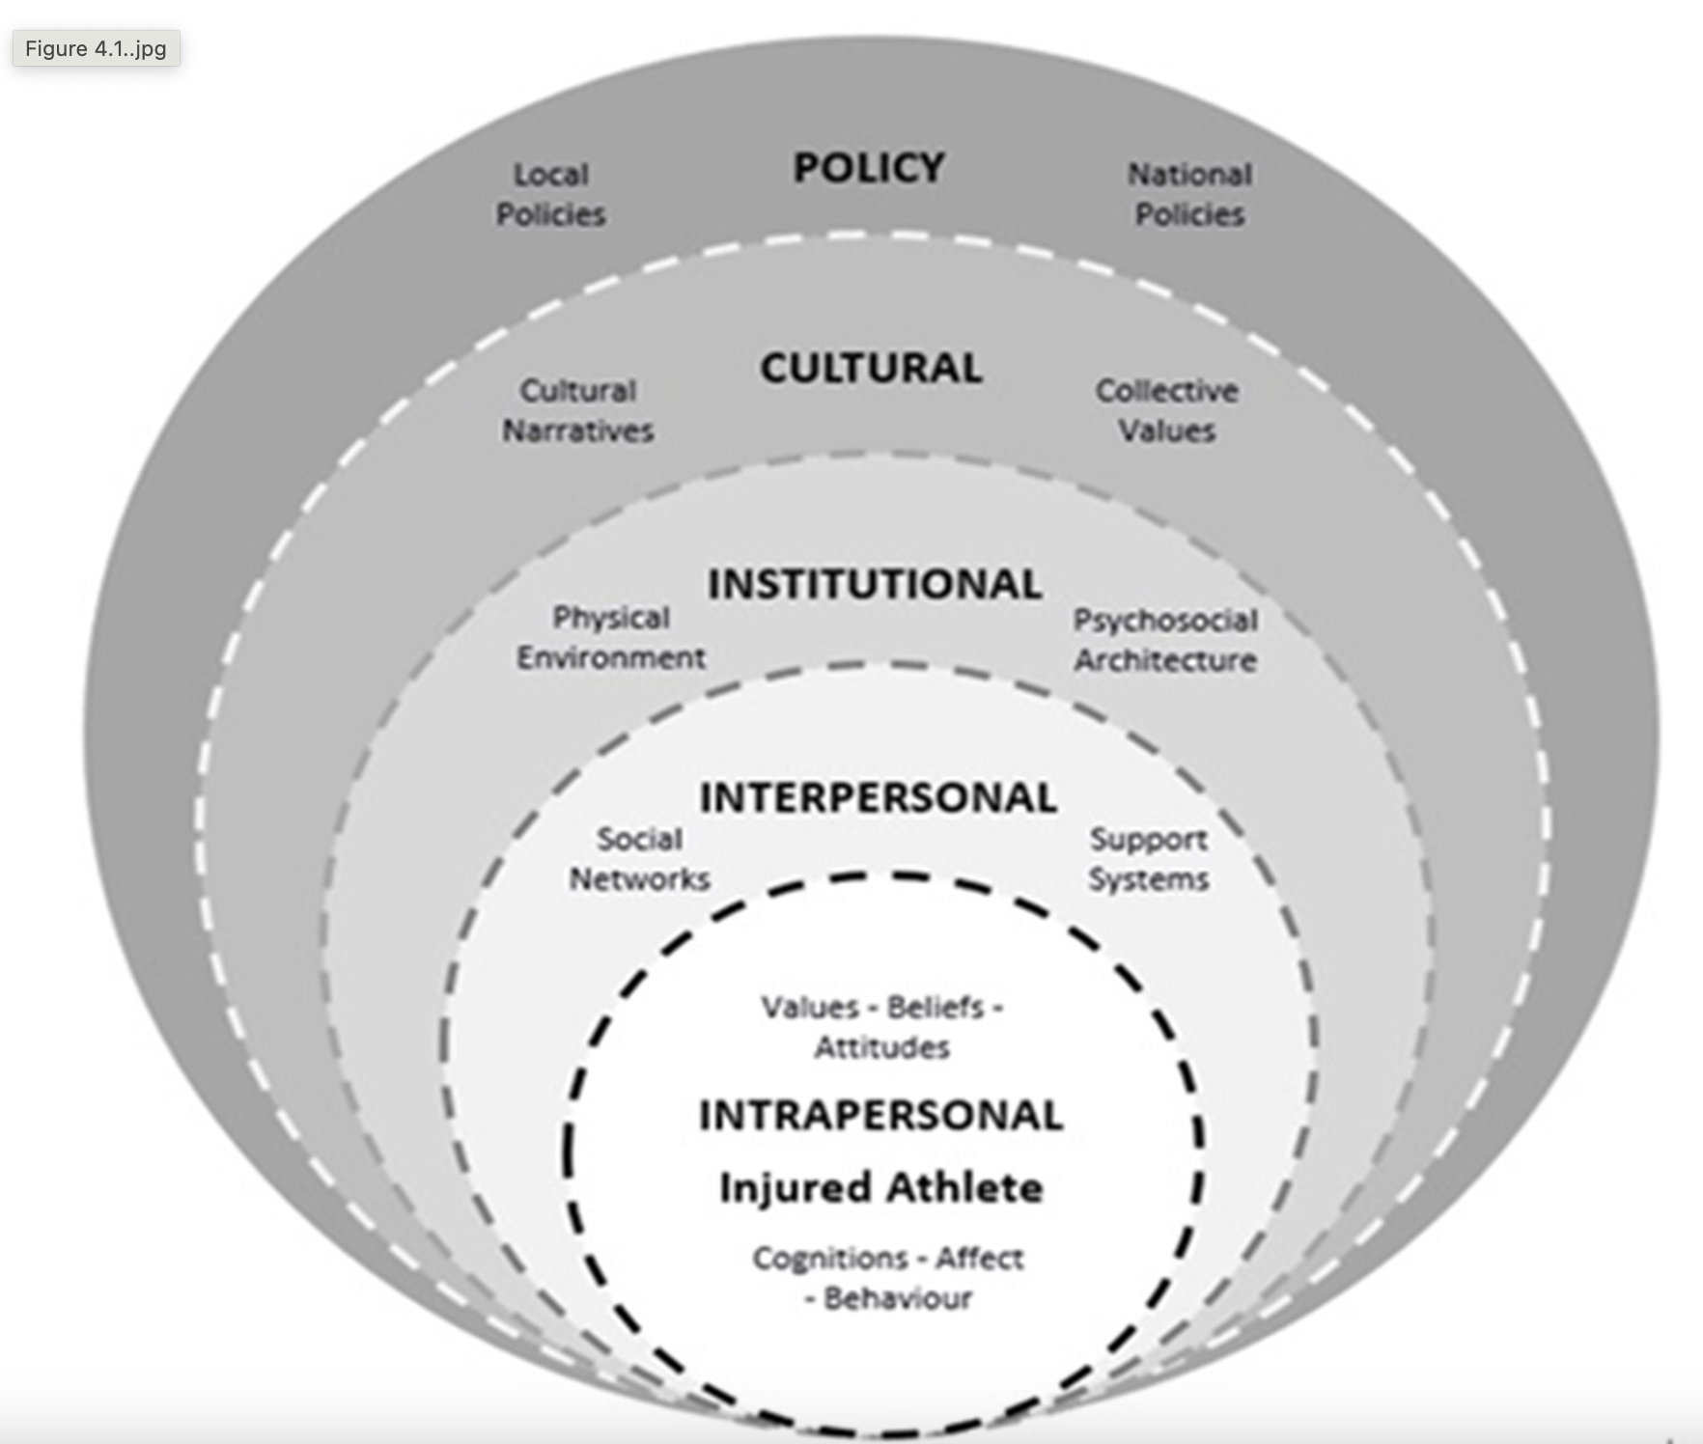
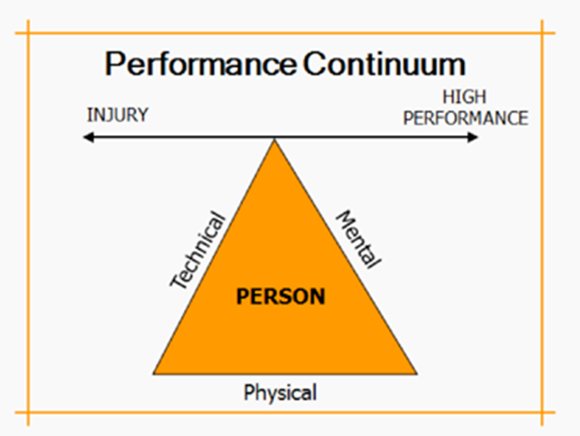
My Practice Philosophy
Athlete-centered and humanistic
with a carefully selected use of CBT strategies, rooted in theory and empirical evidence
Holistic and biopsychosocial
mind-body connection
Interprofessional
where appropriate and possible
Practitioner competent care
within scope of practice
Referral
It’s like finding a better coach
Notes:
So how do I approach my cases I work with?

Slide 7
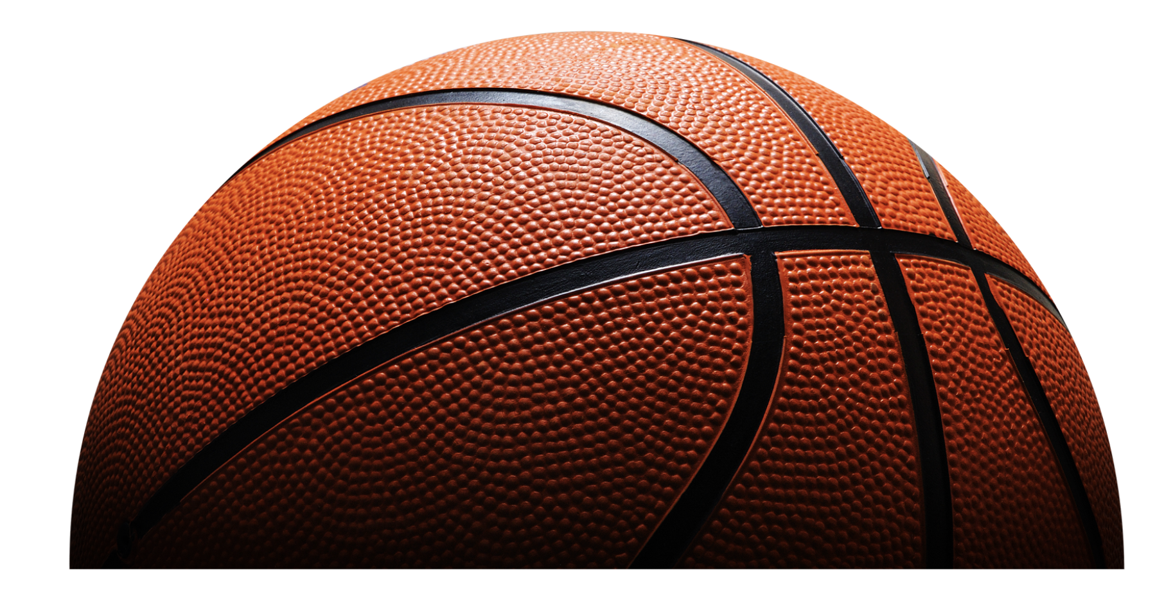
Freshman basketball player, LAS (grade II), diagnosis during pre-season
Evaluation
High level of abstraction
Andersen & Williams, 1998
Diagnosis
Trait anxious athlete
Poor coping skills
Treatment
Low level abstraction
Evidence that many pre-injury factors, post-injury personal and situational factors influenced CA-ER-BR responses to the injury and rehabilitation
History of stressors
Professionals using the same “language”
Medium level of abstraction
Using deep breathing in SPC, AT, and S&C sessions
Interdisciplinary approach
What was taught in SPC sessions, carried over to other sessions
Brewer et al., 2002

Slide 8
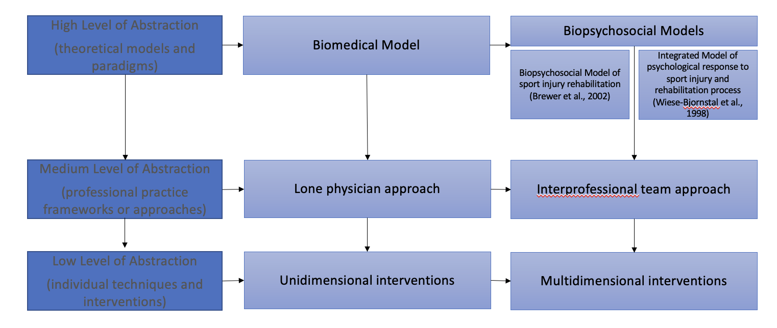
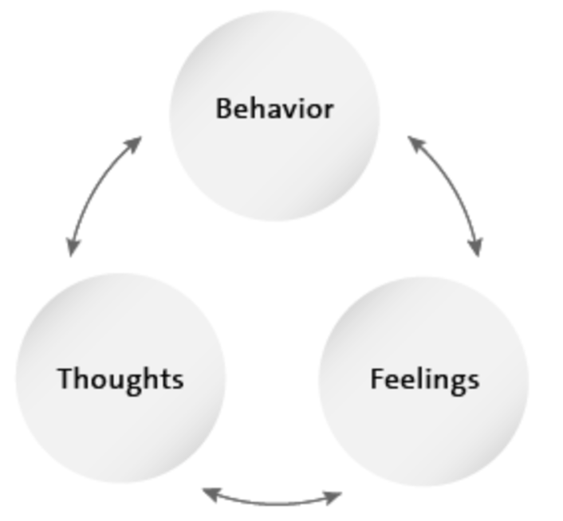
Interventions

Slide 9
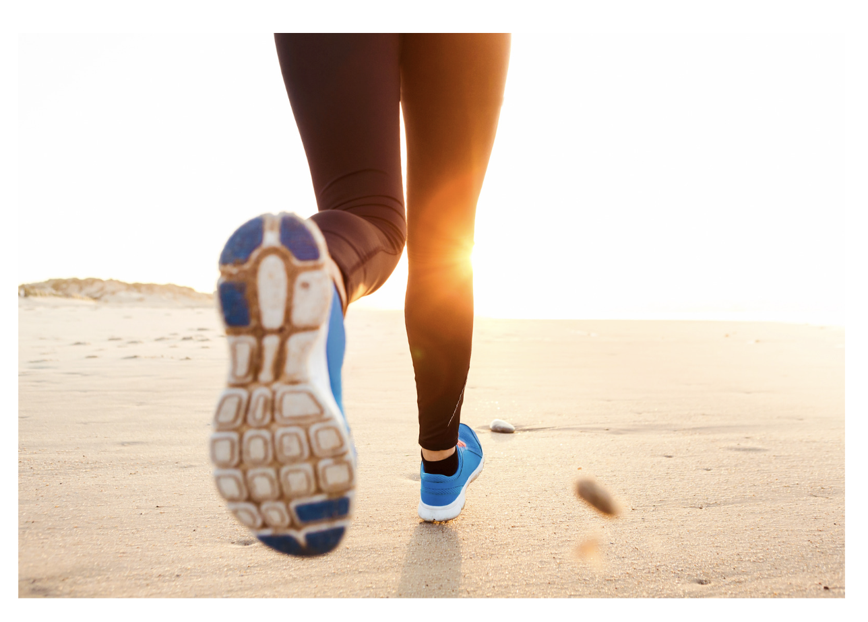
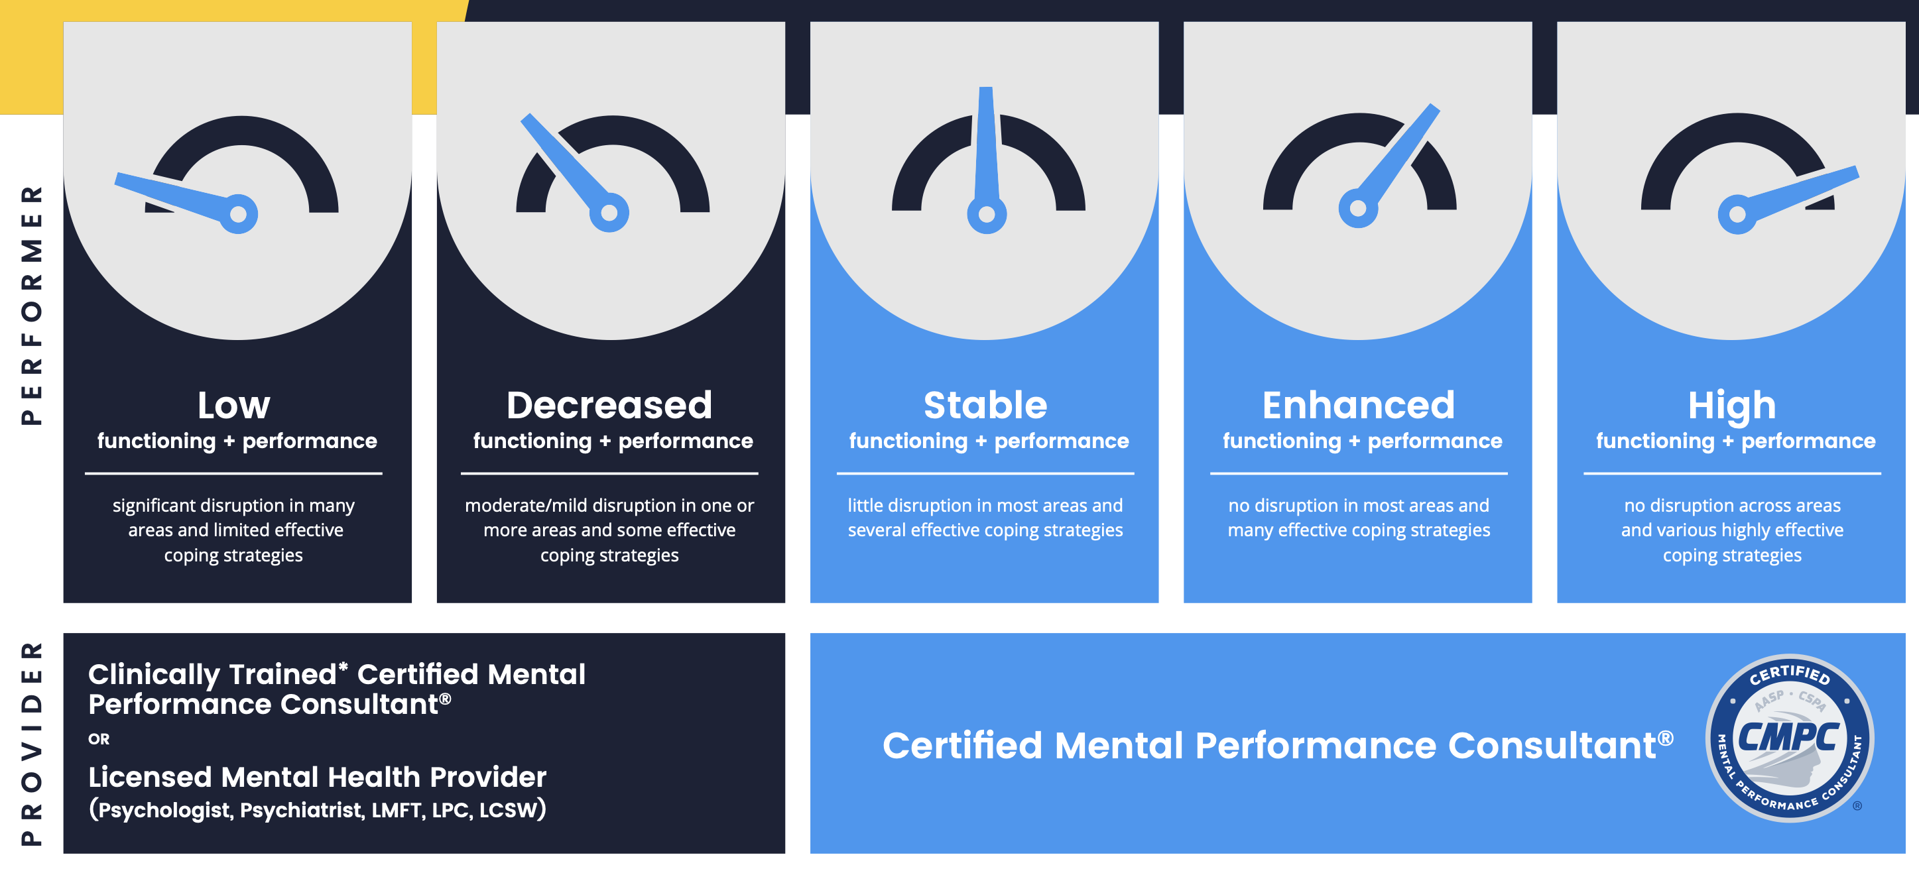
Redshirt JUNIOR Cross country runner, stress fracture in femur, diagnosis during indoor track season)
Evaluation
High level of abstraction
Wiese-Bjornstal et al (1998) model and Brewer et al. 2002 model
Diagnosis
Trait anxious athlete
Poor coping skills, particularly sleep and nutrition, and over adherence
Treatment
Low level abstraction
Evidence that many pre-injury factors influenced CA-ER-BR responses to the injury and rehabilitation
Exercise dependence
Medium level of abstraction
Should have been a transdisciplinary approach, but due to constraints, was not possible. Referral needs, hence turned to a multidisciplinary approach.
More unidimensional interventions, albeit SPC tried to build connections between different factors.
Some evidence of disordered eating

Slide 10
Interventions

Slide 11
Critical success factors
Using theory helped conceptualize and “diagnose” the case from a biopsychosocial perspective
Theory helped identify appropriate professional practice model
Adapting care to current organizational structure – sometimes more successful than others
Theory helped identify multimodal interventions for all professionals involved (who does what)
Effective communication
Trust and rapport between different individuals
Continued evaluation of progress from all aspects

Slide 12
Working with injured athletes: Psychosocial perspective
Ask the athlete to tell their story (Arvinen-Barrow et al., 2020)
It all starts from (primary) appraisal(s) (Brewer & Redmond, 2017)
Meet the athlete where they are at (rooted in consultancy philosophy)
Normalizing cognitive-affective-physiological responses (that’s what literature tells us)
Coping with injury can take many forms (Arvinen-Barrow & Olusoga, 2024; Clement et al., 2019)
Controlling the controllables (where and when to intervene)
CBT strategies of Patient Education and Goal setting (Arvinen-Barrow et al., 2024)
Different stairs can lead to same (or better) outcome

Slide 13
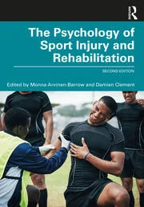
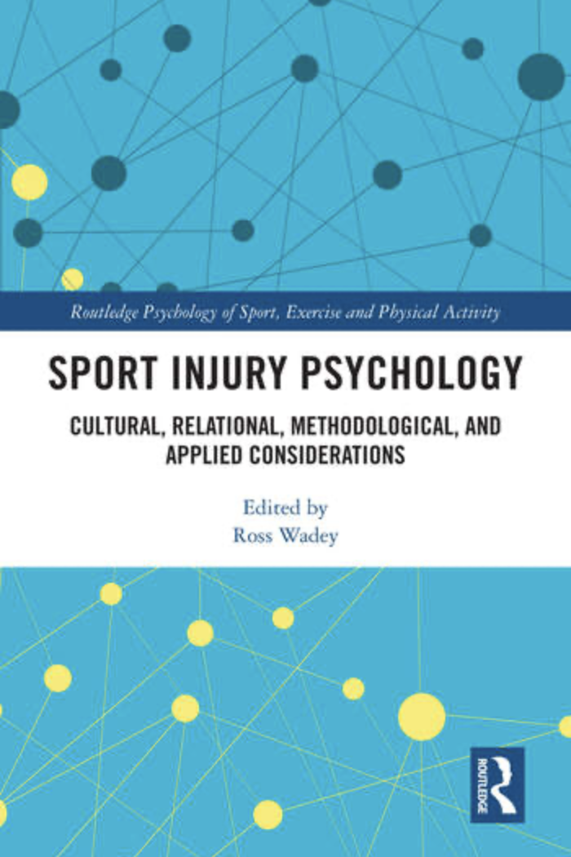
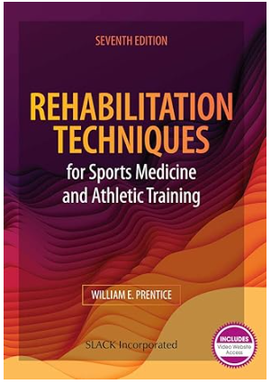
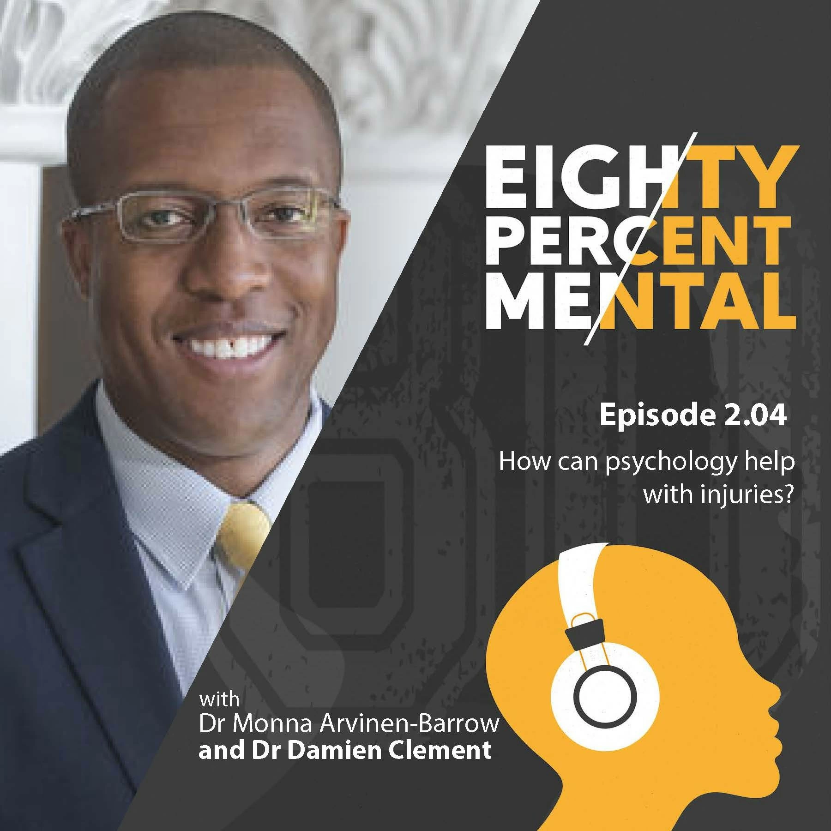
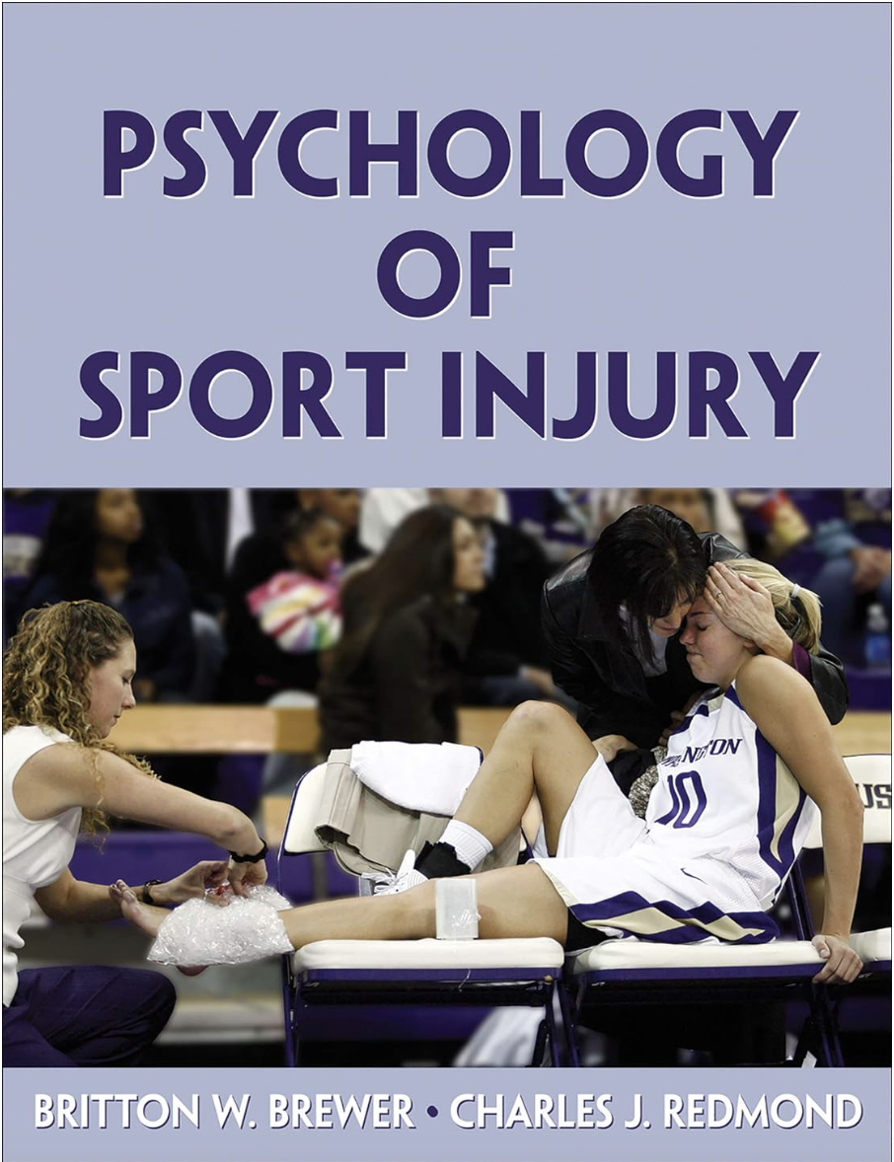
Key Sources

